Slide 1
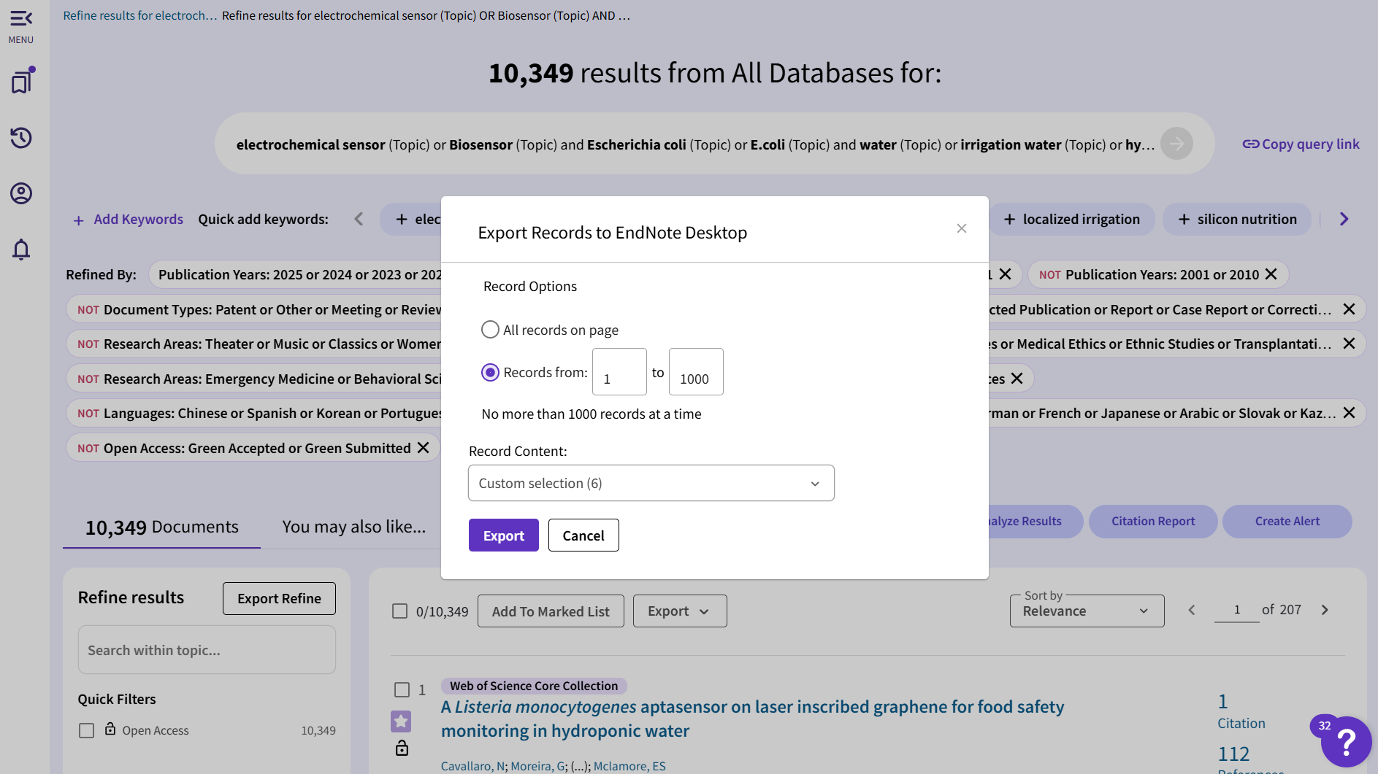
Figure 2. Web of Science (All Databases) export interface showing record-range selection and batch export settings

Slide 2
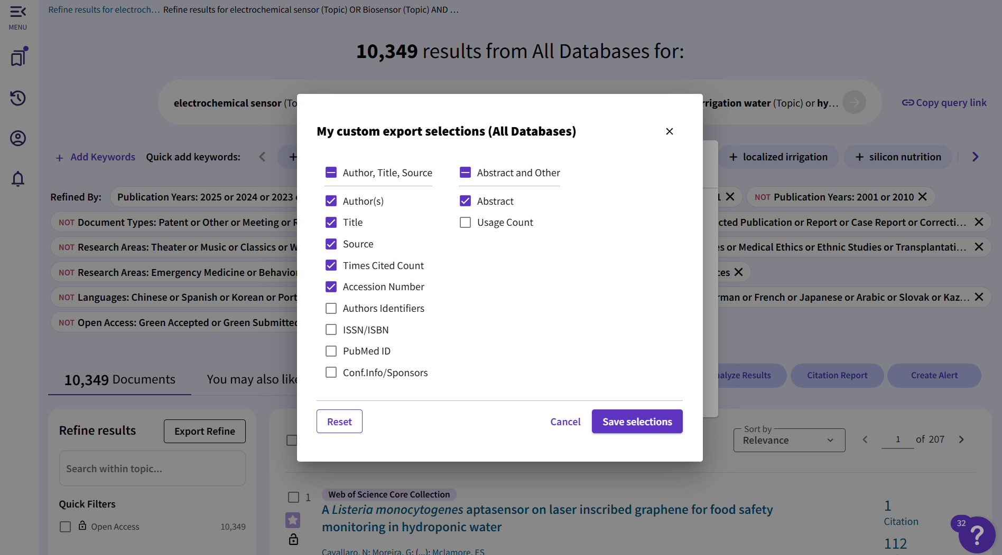
Figure 3. Customized export fields in Web of Science.

Slide 3
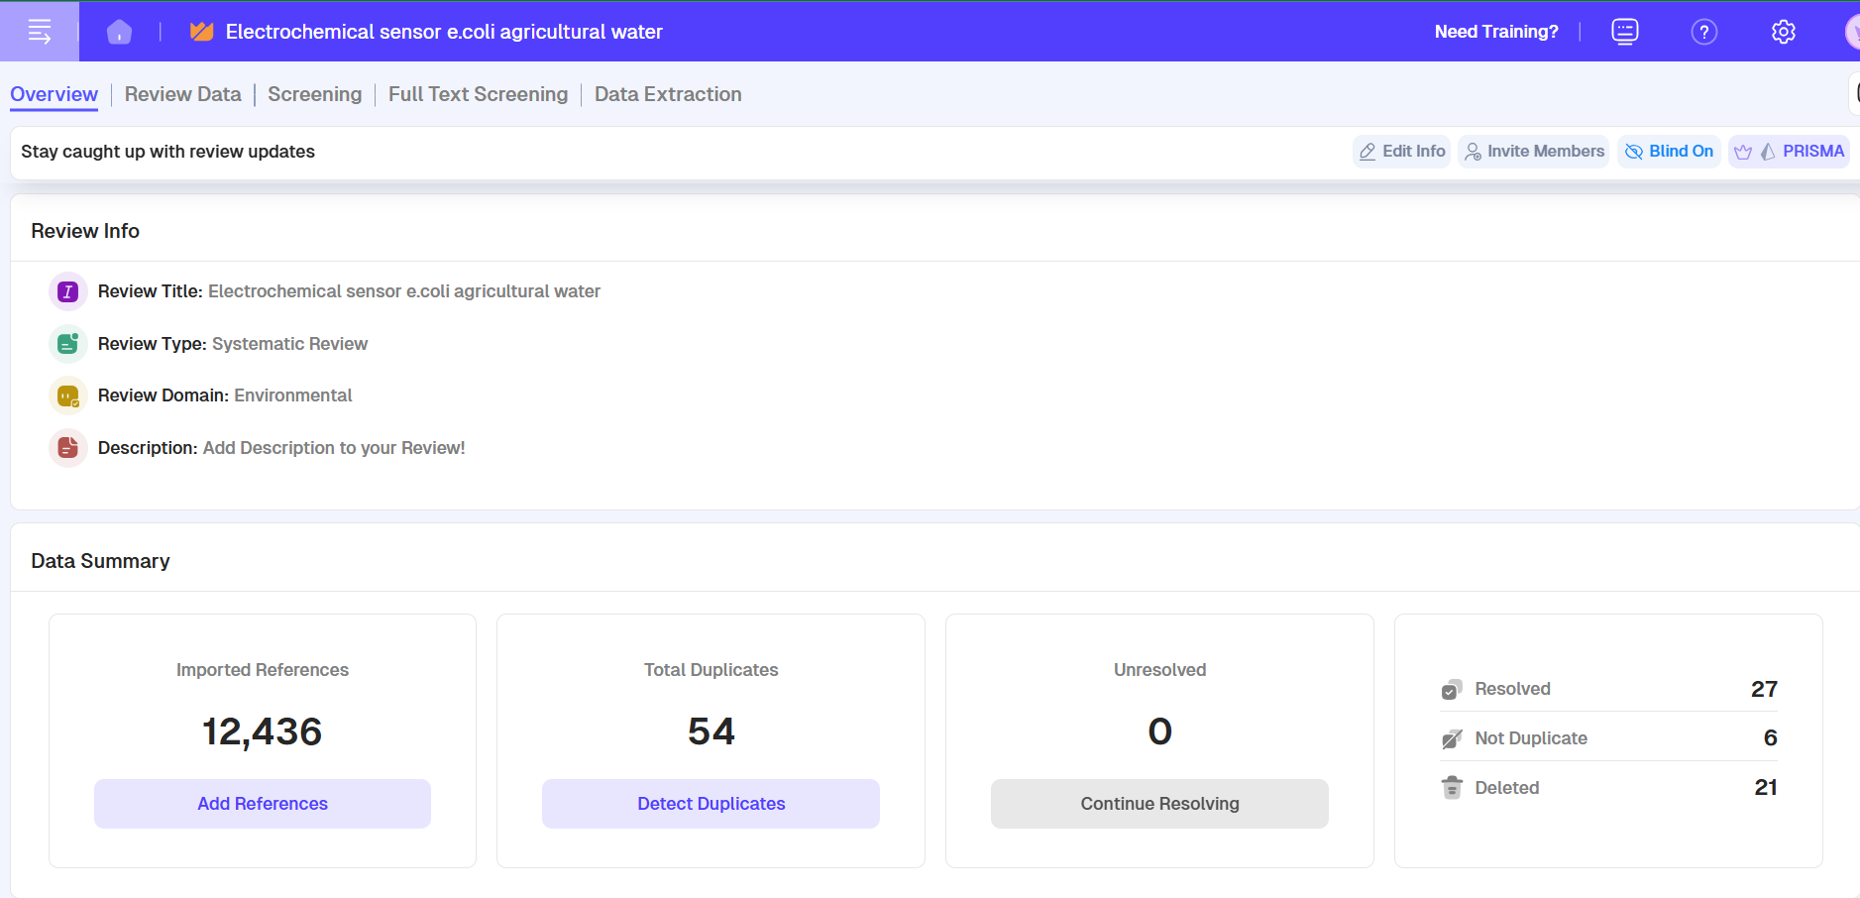
Figure 4. Rayyan duplicate detection view

Slide 4
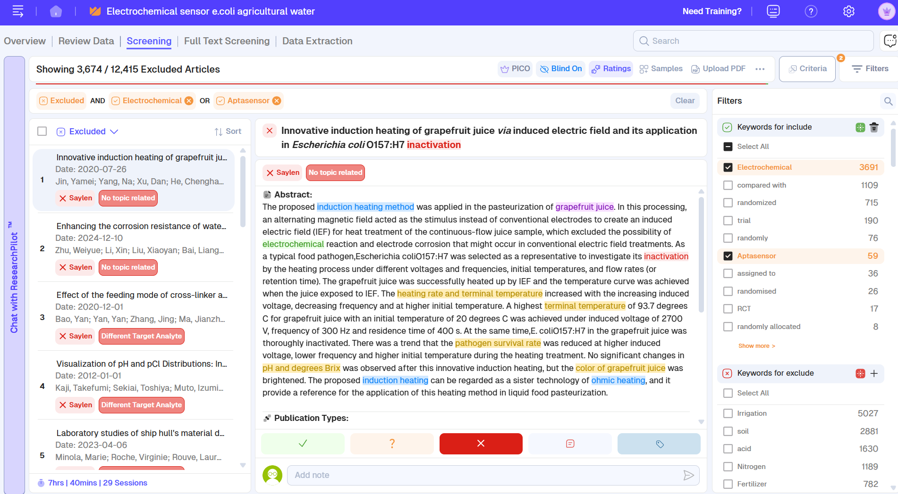
Figure 5. Rayyan desktop interface: Grouping, Title and Abstract View

Slide 5
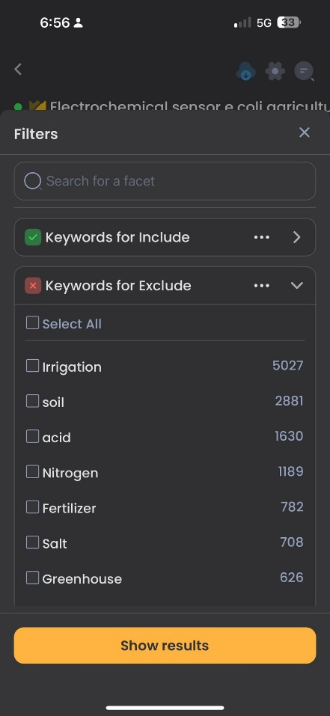
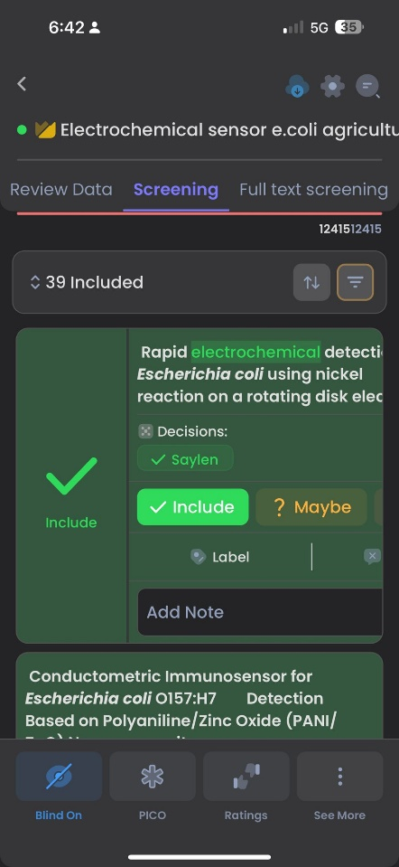
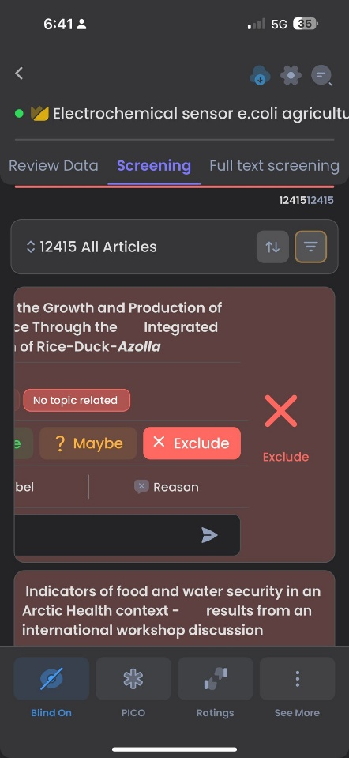
a)
b)
c)
Figure 6. Rayyan Mobile Interface: Grouping, Title and Abstract Flip View. The screening of Rayyan’s mobile interface was used strategically to transform screening into a more intuitive and “game-like” task.

Slide 6
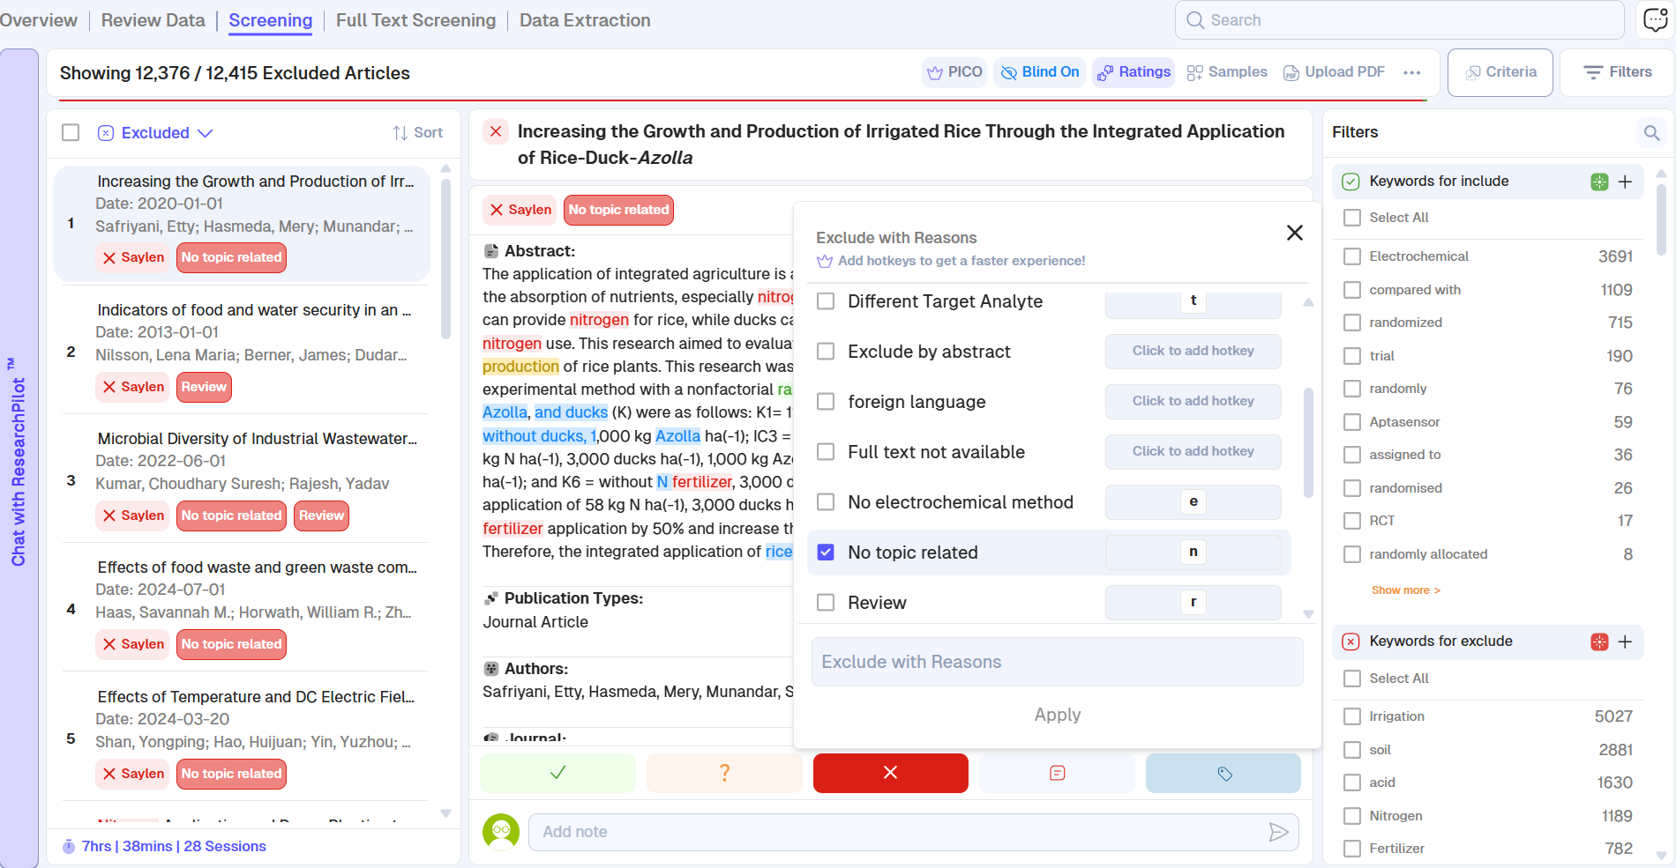
Figure 7. Desktop Screening “Exclude with Reasons” Panel: Title and Abstract View.

Slide 7
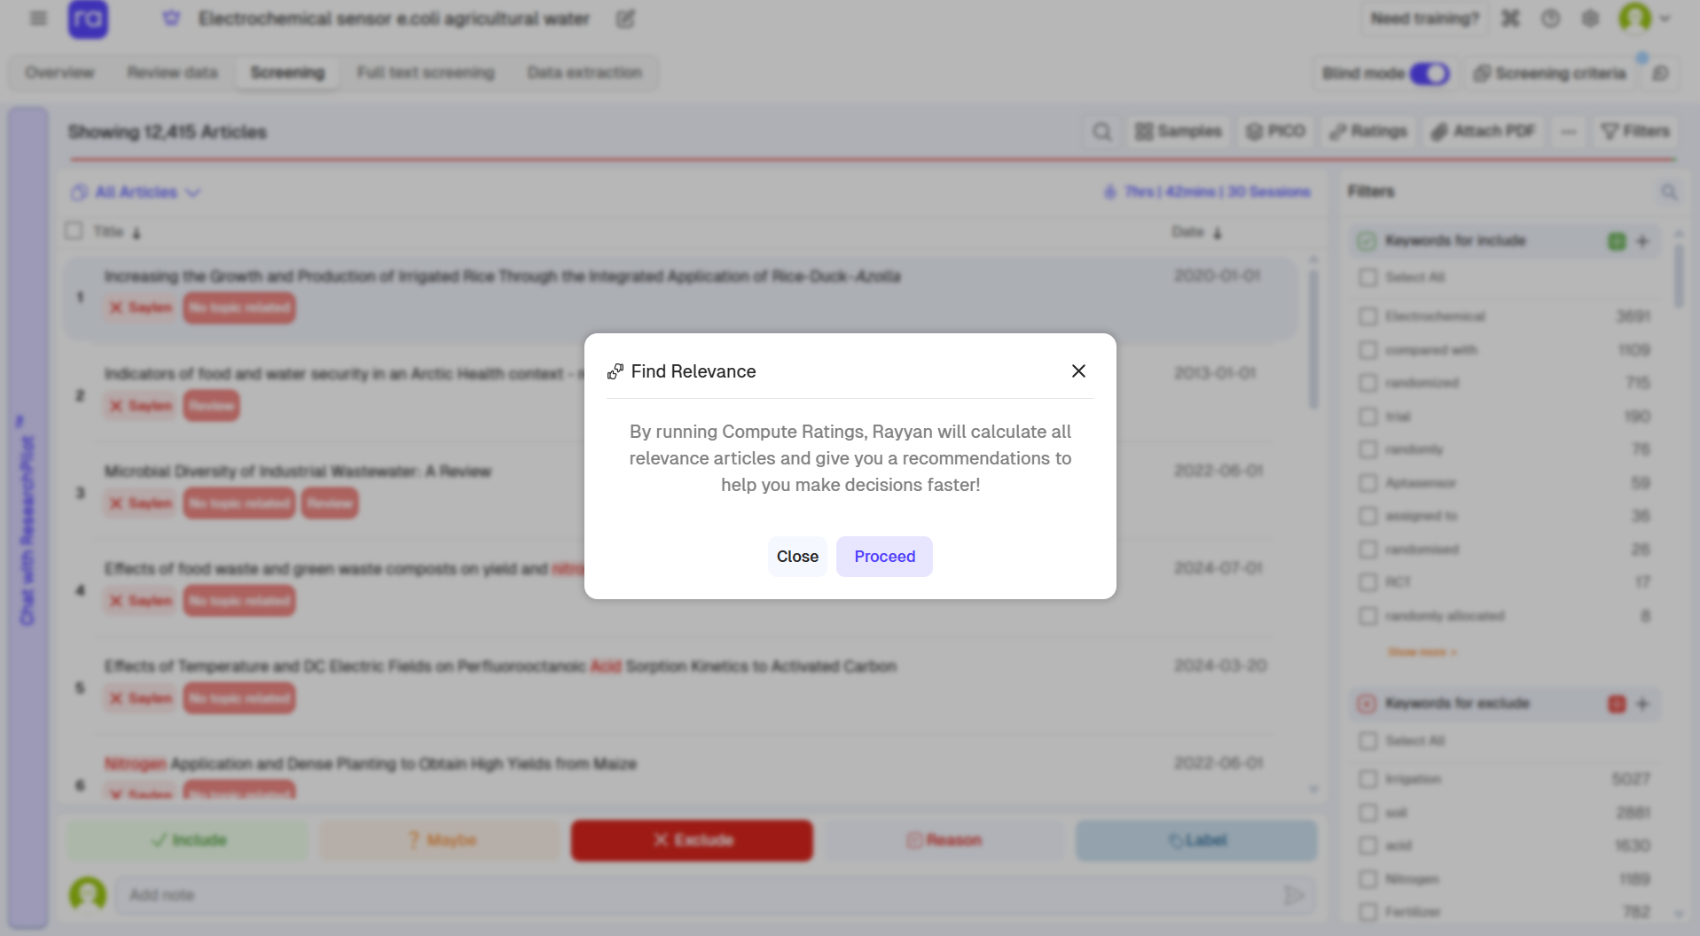
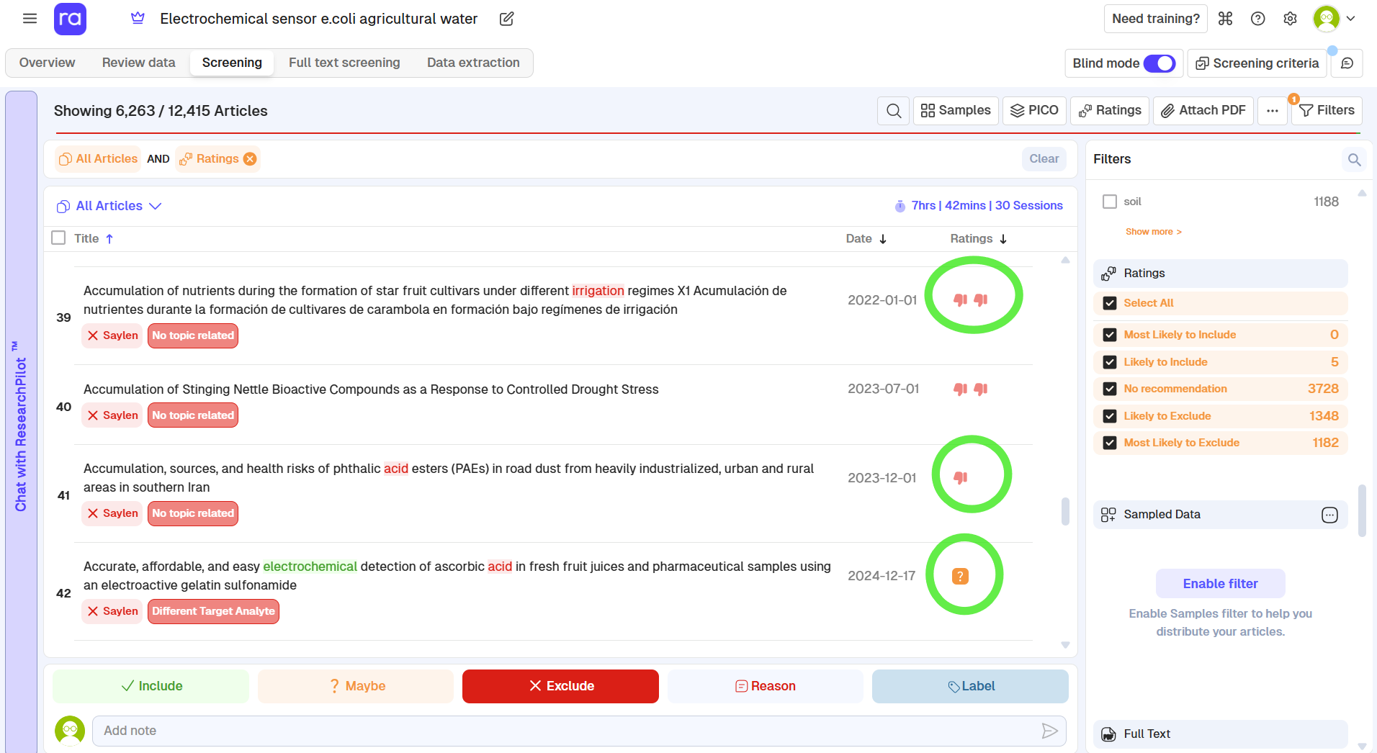
a)
b)

Slide 8
Figure 8. Rayyan relevance prediction feature showing (a) rating definitions and (b) relevance score output for screened records. (two thumbs up): Most likely to include: Articles with the highest probability of inclusion. (one thumb up): Likely to include: Articles with a high probability of inclusion. (question mark): No recommendation: The AI doesn't have enough information to make a confident prediction. This is common early in the screening process. (one thumb down): Likely to exclude: Articles with a high probability of exclusion. (two thumbs down): Most likely to exclude: Articles with the highest probability of exclusion .

